Slide 1

Institute of Technology
School of Computing
Department of Software Engineering
Fundamentals of Cloud computing
“Evolution of Cloud Computing”
By Abebaw S.

Slide 2
Outline
Introduction
System Models for
Distributed Computing
Cloud Computing
NIST Cloud Computing Reference Architecture -IaaS
On-demand provisioning
Elasticity in cloud
Public, Private and Hybrid clouds

Slide 3
Introduction
What is Cloud?
The term Cloud refers to a Network or Internet.
In other words, Cloud is something, which is present at remote location.
What is Cloud Computing?
It refers to manipulating, configuring, and accessing the hardware and software resources remotely
It offers online data storage, infrastructure, and application

Slide 4
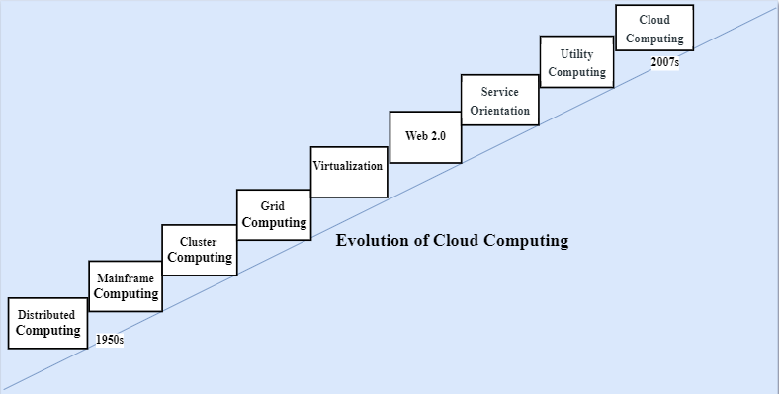
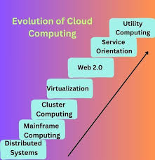
Cont’d . . .

Slide 5
Distributed System
It consists of several separate systems that are all presented to users as a single entity.
Purpose
Share resources and use them effectively and efficiently
Problem
All the systems required to be present at the same geographical location.

Slide 6
Mainframe Computing
Originally introduced in 1951.
Are highly reliable and powerful computing devices
These systems have almost no downtime with high fault tolerance.
After distributed computing, these increased the processing capabilities of the system.
Problem: Very expensive.

Slide 7
Cluster Computing
An alternative to mainframe technology to reduce the cost.
Each machine in the cluster was connected to each other by a network with high bandwidth.
These were equally capable of high computations
New nodes could easily be added to the cluster if it was required.
Geographical restrictions remained a challenge, even if the cost issue was somewhat resolved.

Slide 8
Grid Computing
To solve geographical restriction, the concept of grid computing was introduced.
It was first introduced in the 1990s
Systems were placed at entirely different geographical locations and these all were connected via the internet.
Problem: Limited availability of high bandwidth connectivity, along with other network-related problems.

Slide 9
Virtualization
Virtualization refers to the process of creating a virtual layer over the hardware.
It allows the user to run multiple instances simultaneously on the hardware
It is a key technology used in cloud computing
It is the base for major cloud computing services such as Amazon EC2, Vmware, vCloud etc.

Slide 10
Web 2.0
Web 2.0 refers to the second generation of the World Wide Web
It is the interface through which the cloud computing services interact with the clients.
It characterized by a shift from static web pages to more dynamic and interactive experiences.
It increases flexibility among web pages.
Popular examples of web 2.0 include Google Maps, Facebook, Twitter, etc.

Slide 11
Service orientation
It acts as a reference model for cloud computing
It supports low-cost, flexible, and evolvable applications.
Two important concepts were introduced in this computing model.
QoS: include Service Level Agreement (SLA)
Software as a Service (SaaS)

Slide 12
Utility Computing
Utility computing is a service model that delivers computing resources over the internet.
The resources include processing power, storage, and applications as a metered service.
Resources are provisioned on a pay-per-use basis
It allows users to access and pay for only the resources they consume.

Slide 13
Cloud Computing
Cloud Computing means storing and accessing the data and programs on remote servers that are hosted on the internet.
It also referred to as Internet-based computing
The data that is stored can be files, images, documents, or any other storable document

Slide 14
Cont’d …
Disadvantages
Cost Saving
Data Redundancy and Replication
Flexibility
Reliability
High Accessibility
Scalable
Disadvantages
Internet Dependency
Issues in Security and Privacy
Data Breaches
Limitations on Control

Slide 15
System Models for Distributed Computing
Distributed computing is a system in which processing and data storage are spread across multiple devices or systems
Distributed computing systems can be classified into various models based on their architecture, communication methods, and the way they manage resources.
Physical Model
Architectural Model
Fundamental Model

Slide 16
Cont’d …
1. Physical Model
It represents the HW elements of a distributed system.
Mainly consists of the following components:
Nodes
Links
Middleware
Network Topology
Communication Protocols

Slide 17
Cont’d …
Nodes
Nodes are the end devices that can process data, execute tasks, and communicate with the other nodes.
Links
The communication channels between different nodes and intermediate devices.
The following connection types can be implemented:
Point-to-point
Broadcast links
Multi-Access links

Slide 18
Cont’d …
Middleware
This is a software installed and executed on the nodes.
Middleware enables decentralized control
It manages tasks such as communication between nodes, resource management, fault tolerance, node synchronization, and security to block unauthorized access.
Examples: RPC, JDBC, ODBC etc.

Slide 19
Cont’d …
Network Topology
It defines the arrangement of nodes and links in the distributed computing system.
The most common network topologies used are bus, star, mesh, ring, and hybrid.
Communication Protocols
Are the set rules and procedures for transmitting data from one node to others.
Examples of these protocols include TCP, UDP, HTTPS, MQTT etc.

Slide 20
Cont’d …
2. Architectural Model
It defines the overall design and organization of components,
overview of how development, deployment, and operations will occur.
The main elements of the architectural model are:
Client-Server model
Peer-to-peer model
Layered model
Micro-services model

Slide 21
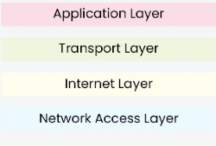
Cont’d …
Layered model
It organizes the system into multiple layers, with each layer providing a specific service.
Each layer interacts with adjacent layers through defined protocols.

Slide 22
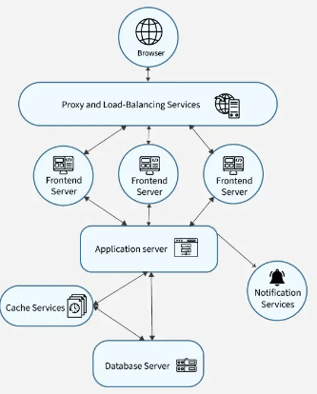
Cont’d …
Micro-services model
A complex application is divided into independent tasks that run on different servers.
Each service performs one function and focuses on a specific business capability.
This makes the system easier to maintain, scale, and understand.

Slide 23
Cont’d …
3. Fundamental Model
It represents the essential components that are required to understand a distributed system’s behavior.
There are three types of fundamental models
Interaction
Fault
Security

Slide 24
Cont’d …
Interaction Model
It handles time (i.e. for process execution, message delivery, clock drifts, etc.)
They are of two types:
Synchronous distributed system
Asynchronous distributed system

Slide 25
Cont’d . . .
Fault Model:
It addresses the faults and failures that occur.
Failures can occur both in processes and communication channels.
Fault tolerance mechanisms are implemented by:
Replication
Error detection
Recovery methods.

Slide 26
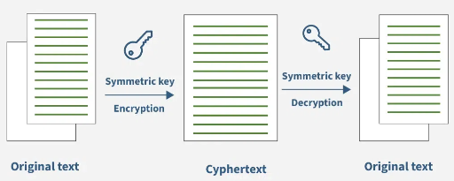
Cont’d . . .
Security Model
It define the security needs, threats, vulnerabilities, and methods to protect the system and its resources.

Slide 27
NIST Cloud Computing Reference Architecture
NIST stands for National Institute of Standards and Technology
It provides a structured framework that defines the basic building blocks of cloud computing
It serves as a reference point for designing, deploying, and managing cloud-based systems.

Slide 28
Cont’d…
NIST cloud computing reference architecture defines five major actors:
Cloud consumer
Cloud provider
Cloud carrier
Cloud auditor and
Cloud broker.

Slide 29
Cloud Consumer
A cloud consumer is an individual or organization that uses services provided by cloud providers.
They need SLAs to specify the technical performance.

Slide 30
Cloud Provider
A cloud provider is an entity responsible for offering cloud services to users
It manages the infrastructure, platforms, or software that consumers use.
Example: Amazon Web Services (AWS), Microsoft Azure, or Google Cloud Platform (GCP)

Slide 31
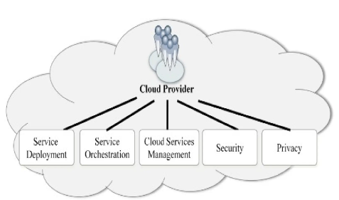
Major activities of cloud provider

Slide 32
Service deployment
Service deployment refers to the process of making an application or service available for use in a cloud environment.
There are various ways cloud services can be deployed.
Private Cloud
Public Cloud
Hybrid Cloud
Community Cloud

Slide 33
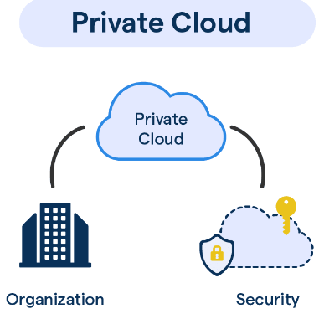
Cont’d…
Private cloud
Allows systems and services to be accessible within an organization
It operated only within a single organization.
It may be managed internally by the organization itself or by third-party.
Benefits
Higher security and privacy
Energy Efficiency
Improve reliability
More control on its resources

Slide 34
Cont’d …
Disadvantages of private cloud
Restricted area of operation
High priced
Limited Scalability
Additional Skills

Slide 35
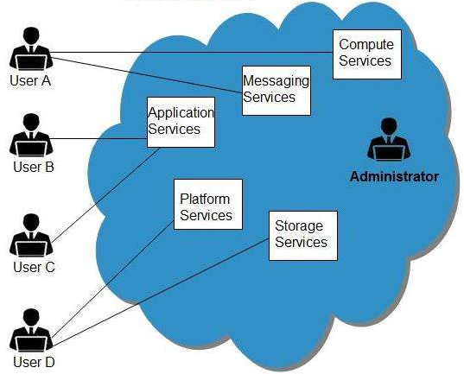
Cont’d…
Public cloud
It allows systems and services to be easily accessible to general public.
Benefits
High Scalability
Utility Style Costing
Cost Effective
Reliability
Flexibility
Location Independent

Slide 36
Cont’d …
Disadvantages of Public Cloud
Low Security
Less Customizable

Slide 37
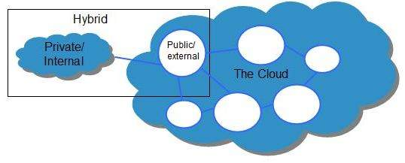
Hybrid Cloud
It is a mixture of public and private cloud.
Non-critical activities are performed using public cloud
Critical activities are performed using private cloud.
Benefits
Scalability
Security
Flexibility
Cost Efficiency

Slide 38
Cont’d …
Disadvantages of Hybrid Cloud
Complex
Security Compliance
Infrastructure Dependency

Slide 39
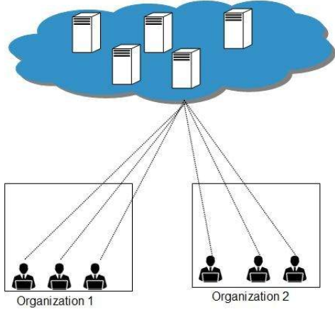
Community Cloud
It allows system and services to be accessible by group of organizations
It shares the infrastructure between several organizations from a specific community
It may be managed internally by organizations or by the third-party.
Benefits
Cost Effective
Sharing
Among Organizations
Security

Slide 40
Cont’d …
Disadvantages of Community Cloud
Relatively high cost
Rarity
Limited bandwidth and storage

Slide 41
Service Orchestration
It refers to activities in arrangement, coordination and management of computing resources
Three Layer
Service Layer
Resource Abstraction and Control Layer
Physical Resource Layer

Slide 42
Cont’d…
Service Layer
This is where individual services reside ( i.e. SaaS, PaaS, IaaS )
Resource abstraction and Control
It involves creating virtual representations of physical computing resources.
Physical Resource Layer
It involves the management and coordination of physical resources in a computing environment.

Slide 43
Cloud Service Management
It refers to the processes and tools used to manage and optimize cloud services throughout their lifecycle.
Example: Configuring and deploying cloud services according to the requirements of the cloud consumers.

Slide 44
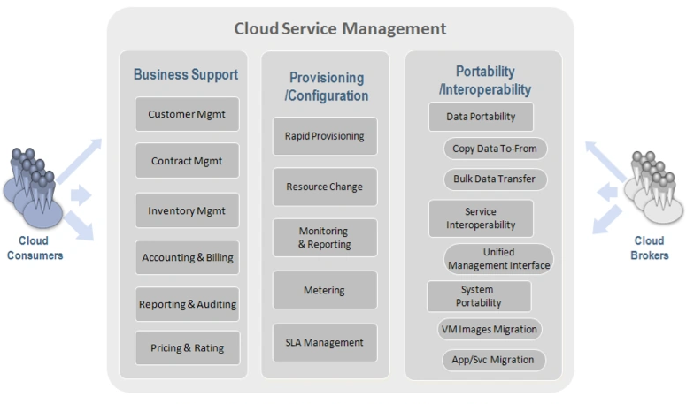
Cont’d …
Fig: Cloud provider – Cloud service management

Slide 45
Cloud Broker
A cloud broker acts as an intermediary between cloud service providers and cloud consumers.
They manage and optimize the use, performance, and delivery of cloud services.
Categories of Cloud Broker Services
Service Intermediation
Service Aggregation
Service Arbitrage

Slide 46
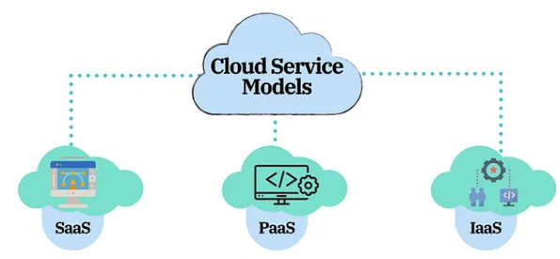
Cloud service Models
There are three types of cloud service models:
Infrastructure as a Service (IaaS)
Platform as a Service (PaaS)
Software as a Service (SaaS)

Slide 47
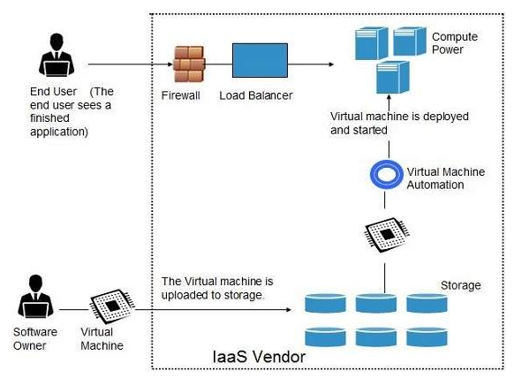
IaaS
It is a provides virtualized computing resources over the internet.
Also known as Hardware as a Service (HaaS)
It Provides the fundamental resources such as: networking equipment, devices, database, and web servers

Slide 48
Cont’d…
Advantages:
Cost-Effective
Security
Maintenance
Disadvantages:
Limited control over infrastructure
Security concerns
Limited access

Slide 49
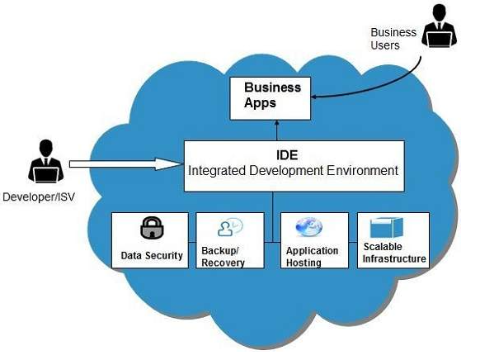
PaaS
PaaS offers the runtime environment for applications.
Offers deployment tools required to develop applications.
PaaS has a feature of point-and-click tools that enables non-developers to create web applications.

Slide 50
Cont’d…
Advantages
Scalability
Prebuilt Business Plan
Low Cost
Instant Community
Simple & easy to use
Disadvantages of PaaS :
Vendor Migration problem
Data-Privacy
Mix-up Complexity

Slide 51
SaaS
SaaS model delivers software applications to end users as a service.
This software is hosted online and accessible through the Internet.
Here are some examples of SaaS applications:
Billing and invoicing system
Customer Relationship Management
Help desk applications
Human Resource solutions etc.

Slide 52
Thank you!

